Slide 1

If Agricultural Land Taxation Is So Efficient, Why Is It So Rarely Used?
Author: Jonathan Skinner
Presenter: Weizhao Huang

Slide 2
Background
Liberalized agricultural, realigned exchange rates, and a reduced role for marketing authorities have created a favorable environment for agricultural growth in many developing countries
But these policies were not without cost and government in these countries lost an important source from the agricultural sector.
They tried to find a way for tax income from the agricultural sector

Slide 3
One prospect
Tax based on land area and quality was put forward as one prospective method for raising revenue, as it has several potential advantages acknowledged by economists in 1980s
Land is readily observable and in fixed supply
Land tax causes no distortion of output prices
Farmers maintains their incentives to produce at high level while receiving full price for crops

Slide 4
Paradoxical facts
The use of land taxation has been reduced during the past several decades
In 1940, agricultural land taxation accounted for 23% of central government tax revenue in Egypt, 19% in India and 5% in Chile.
By 1987, these countries collected no more than 1% of central government revenue and few countries relied more than 3%
When government has a choice, they tend to prefer a strengthening of income or export taxes, or an extension of indirect taxes to land taxes

Slide 5
Purpose of the article
Examines three potential explanations for why land tax is so rarely used in raising central government revenue
Capitalization effect----the prospect of future tax payments depresses current land prices
Undesirable risk characteristics of a land tax in the imperfect insurance markets
Administrative factors ----difficulty in observing site value, problems of compliance

Slide 6
General Model
A tradable commodity x subject to an export tax τ at the border, the domestic price p depends on the export tax and on the world price p* which is constant, (neglecting transportation cost) we can write:
Where j denotes the time period, let p* is equal to 1 in terms of the numeraire non-traded good . This assumption will be hold throughout the analysis.
Assume F have constant return to scale, L_{ij} is the farmer’s labor, T_{ij} is quantity of land and ε_{ij} is multiplicative random variable ( reflecting weather conditions and other factors)

Slide 7
Agricultural Sector
Assume workers are paid their marginal product w_{j}=p_{j}F_{Lj} and the annual rental value of land is p_{j}F_{Tj}. Also, we assume competitive markets and representative farmer subject to uniform random shocks (ε_{ij}=ε_{j}).
Individuals in agricultural sector consumes only the tradable good x, numeraire good z, and leisure l, and each lives for two periods. The expression of expected lifetime utility for individual in agricultural sector is:
Where δ is the time preference rate, E is the expectations operator conditional on information in period 1.

Slide 8
The B.C of agricultural sector in the two periods
At any given time, there are two generations alive. The younger generation provides a L_{j} fraction of time for work. At the end of first period, they choose consumption and use the part of income to purchase assets. ( Thus only older generation owns land or capital)
The B.C in the second period
Where Q is the price of one unit of land, traditional assets K pay a fixed, untaxed rate of return r.
By substituting K, We can also express equation as:

Slide 9
Agricultural Sector
The arbitrage condition for the price of land holds in a world of certainty and in steady- state equilibrium in which Q_{j}=Q_{j+1}, that is one dollar invested in land should yield the same net return as the same dollar in capital K
The utility function in its indirect form, as a function of prices and income:

Slide 10
The urban sector
The individuals in urban sector purchase the tradable good x from the agricultural sector. Holding other prices constant, the indirect utility function is :
For a given tax regime (τ,Γ), the present value of aggregate tax revenue can be expressed
Where Xa and Xb are the present value of aggregate expenditures on x goods by the rural and urban consumers

Slide 11
Urban-Rural Welfare Comparisons
Land tax in place of export tax will affect:
The production incentives of farmers
Prices paid urban consumers for the good x
Depending on their landholdings and productivity
As a means of quantifying these comparisons between urban and rural individuals, the social welfare is written as :
Where U^{ak} reflects the utility of farmers with different landholdings k

Slide 12
Land Taxation and Capitalization Effects
Approach :Simplify the former general model, just assume individual retires in the second period and the production is linear. The strategy used is based on the marginal shadow-price analysis in short run and long run:
When an increase in the lowest social cost is coupled with a revenue-neutral decline in the tax with highest social cost, a welfare- improving reform occurs.

Slide 13
Land Taxation and Capitalization Effects(SR)
By expressing Uª and U^{b} in terms of their indirect utility functions and using Roy’s identity, we can write the short-run(SR) impact of the land tax on social welfare is
With appropriate substitution and normalization, it can be rearranged like
It means , holding the interest rate constant, the landowner is worse off by (1+r)/r for every increase in tax revenue of $1. It’s very costly to the current generation of landowners.

Slide 14
Land Taxation and Capitalization Effects(LR)
While both Q₁ and Q₂ adjust to the tax regime, the marginal impact of the land tax on social welfare in the long run is given by:
In the long run, future generation bear no burden but gain revenue at the expense of the landowners alive. In sum, a life cycle implies that the land taxation is never “lump sum”.

Slide 15
Export Taxation and Capitalization Effects(SR)
Again in short run, the older generation suffers a capital loss when the export tax is increased. Additional effects of the export tax are (1) wage rate falls, and (2) the domestic price of the tradable x declines.
The overall impact on social welfare is
Where the parameter Ψ_{b} summarizes the weight that the social welfare function places on marginal consumption of x by urban consumers relative to the agricultural consumers

Slide 16
Export Taxation and Capitalization Effects(LR)
The stylized economy jumps to a new steady state, the expression of the marginal social cost is
Where the numerator describes the negative shift in money income. The denominator reflects the present value of the change in revenue.
If we suppose that the urban consumers are weighted equally in the social welfare function and that present value of total consumption exceeds first-period earnings, then λ(LR) <0.

Slide 17
Land Taxation and Risk Analysis
Focuses on economic behavior in the second period and collapses the model to a traditional one-period framework.
The Question : what is the magnitude of uncertainty necessary to find the export tax is better?
Subject to budget constraint
Use iterative methods, Γ* is determined such that

Slide 18
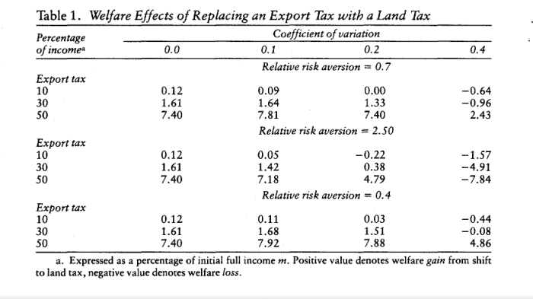
Land Taxation and Risk Analysis
The numbers shown are a measure of compensating variation as a fraction of full income. We can see as the uncertainty in production becomes more pronounced, the export tax can dominate land taxation.

Slide 19
Land Taxation and Risk Analysis
Hoff demonstrated that a combination of a land tax to raise revenue and an export tax to stabilize income dominates either tax in isolation
There is an optimal tradeoff between the insurance benefits of an export tax and the improved incentives of a land tax
Example: Uruguay, cattle ranchers

Slide 20
Land Taxation and Administrative Cost
The Question: why countries have had a harder time administering the land tax than the other types of tax
Focus instead on second-period production decisions of landowners. Assume all life cycle capital is invested in land and all marketed sales of x bypass the urban sector.
Assume two types of people with identical plot sizes, person n and person b. Expected full income is:
After administrative costs is
Note π1 is probability that the agency incorrectly assesses the high quality land as normal land. And ξ>1 units of effective labor, βT effective units of land.

Slide 21
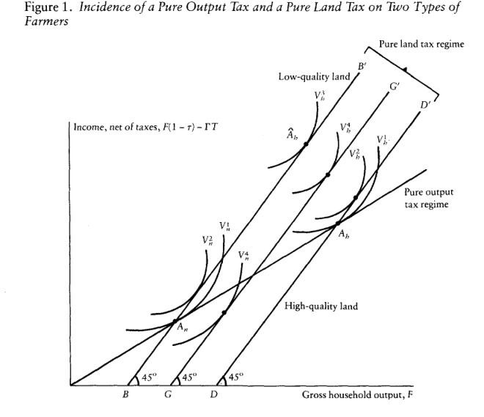
Land Taxation and Administrative Cost
Line BB’ and DD’ reflect the after-tax budget lines of the low-quality and high-quality types

Slide 22
Land Taxation and Administrative Cost
Again, we are concerned here with marginal social cost of increasing cost on administration and raising revenue by increasing the land tax rate.
One example: assume high farmers enjoy half the weight in the social welfare function, and β=2, Γ=2.5%, π₁=0.25, π₂=0, π₁₁=−100,π₁₂=50. Then the marginal social cost of raising $1 extra revenue through export tax rate, land tax assess effort or land tax rate are

Slide 23
Conclusion
The reason of capital loss is not convincing, as export taxes also depress land prices and land tax may even increase land prices.
Numerical calculations suggested it may be the case with large uncertainty and low level of taxation.
Incentive leads to a tendency toward a pooling equilibrium------all farmers pay the same fee per acre. The land tax may be less efficient if administration cost is included.
Solution: a crude index of land quality depending on soil type, irrigation type etc
Local government VS Central government----few other instruments, modest land tax rate

Slide 24
Reflection on this analysis
The analysis is based on the assumption that efficiency and equity consideration guide the government tax choices, without considering political opposition and interests.
The model is quite simple by itself. It ignores rural-urban migration, the impact of taxation on urban land and income, and variation in international exchange rates
Difficult to measure the factor beyond standard economic model
Lack of particular application to a particular country

